Slide 1
Module 4: Social Engineering Attacks
Instructor Materials
Ethical Hacker
Notes:
Ethical Hacker Module 4: Social Engineering Attacks

Slide 2
Instructor Materials – Module 4 Planning Guide
This PowerPoint deck has two parts:
Instructor Planning Guide
Information to help become familiar with the module
Teaching aids
Instructor Class Presentation
Optional slides to use in the classroom
Begins on slide # 7
Note: Remove the Planning Guide from this presentation before sharing it with anyone.

Slide 3
What to Expect in this Module
To facilitate learning, the following features within the UI may be included in this module:
Feature | Description
Avatar | A virtual character representing a subject matter expert adds contextual information to the students' skills and helps them connect the dots by asking open-reflection questions.
Videos | Expose learners to new skills and concepts.
Practice | A variety of formats to help learners gauge content understanding.
Hands-On Labs | Labs designed for working with physical equipment.
Module Quizzes | Self-assessments that integrate concepts and skills learned throughout the series of topics presented in the module.
Module Summary | Briefly recaps module content.

Slide 4
Module 4: Activities
What activities are associated with this module?
Page # | Activity | Activity Name | Optional?
4.1.2 | Practice | Practice - Pretexting / Impersonation | Recommended
4.2.7 | Practice | Practice - Pivot Attack | Recommended
4.2.8 | Practice | Practice - Social Engineering Attacks | Recommended
4.3.6 | Practice | Practice - Physical Attacks | Recommended
4.4.4 | Practice | Practice - Browser Exploitation Framework | Recommended
4.4.6 | Practice | Practice - Call Spoofing Tools | Recommended
4.4.7 | Lab | Lab - Explore the Social Engineering Toolkit (SET) | Recommended
4.4.8 | Lab | Lab - Using the Browser Exploitation Framework (BeEF) | Recommended
4.5.2 | Practice | Practice - Methods of Influence | Recommended
4.6.3 | Module Quiz | Quiz - Social Engineering Attacks | Recommended

Slide 5
Module 4: Best Practices
Prior to teaching Module 4, the instructor should:
Review the activities and assessments for this module.
Try to include as many questions as possible to keep students engaged during a classroom presentation.
Topic 4.1
Compare, contrast, and discuss various social engineering attacks
Ask students, maybe in small group, to research recent social engineering attack cases
Encourage students to complete Practice - Pretexting and Impersonation
Topic 4.2
Discuss different types of phishing schemes
Discuss the potential risks to use a USB stick from unknown resource
Encourage students to complete Practice – Pivot Attack
Encourage students to complete Practice - Social Engineering Attacks

Slide 6
Module 4: Best Practices (Cont.)
Topic 4.3
Compare, contrast, and discuss different types of physical attacks
Ask students, maybe in small group, to research and summarize a physical attack case
Encourage students to complete Practice – Physical Attacks
Topic 4.4
Discuss two social engineering tools, SET and BeEF, what is their function, similarity and difference
Encourage students to complete Practice – Browser Exploitation Framework
Encourage students to complete Lab – Explore the Social Engineer Toolkit (SET)
Encourage students to complete Lab – Using the Browser Exploitation Framework (BeEF)
Topic 4.5
Discuss social engineering motivation techniques/methods of influence
Encourage students to complete Practice – Methods of Influence
Encourage students to complete Quiz – Social Engineering Attacks

Slide 7

Module 4: Social Engineering Attacks
Ethical Hacker
Notes:
Ethical Hacker Module 4: Social Engineering Attacks

Slide 8
Module Objectives
Module Title: Social Engineering Attacks
Module Objective: Explain how social engineering attacks succeed.
Topic Title | Topic Objective
Pretexting for an Approach and Impersonation | Explain how pretexting is used in social engineering attacks.
Social Engineering Attacks | Explain different types of social engineering attacks.
Physical Attacks | Explain different types of physical attacks.
Social Engineering Tools | Explain how social engineering attack tools facilitate attacks.
Methods of Influence | Explain how social engineering attacks enlist user participation.

Slide 9
4.1 Pretexting for an Approach and Impersonation
Notes:
4: Social Engineering Attacks 4.1: Pretexting for an Approach and Impersonation

Slide 10
Pretexting for an Approach and Impersonation
Overview
Social engineering attacks: Attacks against the weakest link, which is the human element such as phishing, vishing, pharming, spear phishing, whaling, and others.
There are other social engineering techniques such as elicitation, interrogation, and impersonation.
Elicitation is the act of gaining knowledge or information from people. In most cases, an attacker gets information from a victim without directly asking for that particular information.
Interrogation is how an attacker interacts with a victim for the success of a social engineering campaign. The interrogator can then use any information the target revealed to continue to gather additional information or to obtain information from another victim.
Impersonation is when an attacker presents as someone else in order to gain access to information. Social engineers may use pretexting to impersonate individuals in certain jobs and roles even if they do not have experience in those jobs or roles. Pharming is a type of impersonation attack in which a threat actor redirects a victim from a valid website or resource to a malicious one that could be made to appear as the valid site to the user. From there, an attempt is made to extract confidential information from the user or to install malware in the victim’s system
There are also different motivation techniques (or methods of influence).
Shoulder surfing is when someone obtains information such as personally identifiable information (PII), passwords, and other confidential data by looking over a victim’s shoulder.
Notes:
4: Social Engineering Attacks 4.1: Pretexting for an Approach and Impersonation 4.1.1: Overview
4.1.2: Practice - Pretexting and Impersonation

Slide 11
4.2 Social Engineering Attacks
Notes:
4: Social Engineering Attacks 4.2: Social Engineering Attacks

Slide 12
Social Engineering Attacks
Overview
Social engineering can be accomplished through email or misdirection of web pages and prompting a user to click something that leads to the attacker gaining information.
Social engineering can also be done in person by an insider or an outside entity or over the phone.
A primary example is attackers leveraging normal user behavior.
Notes:
4: Social Engineering Attacks 4.2: Social Engineering Attacks 4.2.1: Overview

Slide 13
Social Engineering Attacks
Email Phishing
With phishing, an attacker presents to a user a link or an attachment that looks like a valid, trusted resource. When the user clicks it, he or she is prompted to disclose confidential information such as his or her username and password.
Spear phishing is a phishing attempt that is constructed in a very specific way and directly targeted to specific groups of individuals or companies. The attacker studies a victim and the victim’s organization in order to be able to make emails look legitimate and perhaps make them appear to come from trusted users within the company.
Whaling, which is similar to phishing and spear phishing, is an attack targeted at high-profile business executives and key individuals in a company. Like threat actors conducting spear phishing attacks, threat actors conducting whaling attacks also create emails and web pages to serve malware or collect sensitive information; however, the whaling attackers’ emails and pages have a more official or serious look and feel.
The main goal in whaling attacks is to steal sensitive information or compromise the victim’s system and then target other key high-profile victims.
Notes:
4: Social Engineering Attacks 4.2: Social Engineering Attacks
4.2.2: Email Phishing

Slide 14
Social Engineering Attacks
Vishing
Vishing (which is short for voice phishing) is a social engineering attack carried out in a phone conversation. The attacker persuades the user to reveal private personal and financial information or information about another person or a company.
The goal of vishing is typically to steal credit card numbers, Social Security numbers, and other information that can be used in identity theft schemes. Attackers may impersonate and spoof caller ID to hide themselves when performing vishing attacks.
Notes:
4: Social Engineering Attacks 4.2: Social Engineering Attacks
4.2.3: Vishing

Slide 15
Social Engineering Attacks
Short Message Service (SMS) Phishing
Because phishing has been an effective tactic for threat actors, they have found ways other than using email to fool their victims into following malicious links or activating malware from emails. Phishing campaigns often use text messages to send malware or malicious links to mobile devices.
You can help mitigate SMS phishing attacks by not clicking on links from any unknown message senders.
You should not click on any links sent via text messages if you did not expect such a message to be sent to you.
Similarly, if you receive a message saying that there is a problem with a credit card transaction or a bill, call the bank directly instead of clicking on a link.
If you receive a message telling you that you have won something, it’s probably an SMS phishing attempt, and you should not click the link.
Notes:
4: Social Engineering Attacks 4.2: Social Engineering Attacks
4.2.4: Short Message Service (SMS) Phishing

Slide 16
Social Engineering Attacks
Universal Serial Bus (USB) Drop Key
Many pen testers and attackers have used USB drop key attacks to successfully compromise victim systems.
This type of attack involves just leaving USB sticks unattended or placing them in strategic locations. Oftentimes, users think that the devices are lost and insert them into their systems to figure out whom to return the devices to; before they know it, they are downloading and installing malware.
Another social engineering technique involves dropping a key ring containing a USB stick that may also include pictures of kids or pets and an actual key or two. These types of personal touches may prompt a victim to try to identify the owner in order to return the key chain.
Notes:
4: Social Engineering Attacks 4.2: Social Engineering Attacks
4.2.5: Universal Serial Bus (USB) Drop Key

Slide 17
Social Engineering Attacks
Watering Hole Attacks
A watering hole attack is a targeted attack that occurs when an attacker profiles websites that the intended victim accesses. The attacker then scans those websites for possible vulnerabilities.
If the attacker locates a website that can be compromised, the website is then injected with code that is designed to redirect the user when the user returns to that site.
The user is then redirected to a site with some sort of exploit code.
Watering hole attacks are often designed to profile users of specific organizations.
To avoid having a website compromised as part of such an attack, an administrator should use proper programming methods and scan the organization’s website for malware regularly.
User education is paramount to help prevent these types of attacks.
Notes:
4: Social Engineering Attacks 4.2: Social Engineering Attacks
4.2.6: Watering Hole Attacks
4.2.7: Practice - Pivot Attack
4.2.8: Practice - Social Engineering Attacks

Slide 18
4.3 Physical Attacks
Notes:
4: Social Engineering Attacks 4.3: Physical Attacks

Slide 19
Physical Attacks
Overview
As a penetration tester or red teamer, you might be asked to simulate what a real-world threat actor or criminal can do to compromise an organization’s physical security in order to gain access to infrastructure, buildings, systems, and employees.
Notes:
4: Social Engineering Attacks 4.3: Physical Attacks 4.3.1: Overview

Slide 20
Physical Attacks
Tailgating
With piggybacking, an unauthorized person tags along with an authorized person to gain entry to a restricted area – usually with the person’s consent.
Tailgating is essentially the same but with one difference: It usually occurs without the authorized person’s consent.
Both piggybacking and tailgating can be defeated through the use of access control vestibules.
An access control vestibule is a small space that can usually fit only one person. It has two sets of closely spaced doors; the first set must be closed before the other will open, creating a sort of waiting room where people are identified (and cannot escape).
Multifactor authentication is often used in conjunction with an access control vestibule.
Notes:
4: Social Engineering Attacks 4.3: Physical Attacks 4.3.2: Tailgating

Slide 21
Physical Attacks
Dumpster Diving
With Dumpster diving, a person scavenges for private information in garbage and recycling containers.
To protect sensitive documents, an organization should store them in a safe place as long as possible.
When it no longer needs the documents, the organization should shred them.
Dumpster divers might find information on paper and on hard drives or removable media.
Notes:
4: Social Engineering Attacks 4.3: Physical Attacks 4.3.3: Dumpster Diving

Slide 22
Physical Attacks
Shoulder Surfing
With shoulder surfing, someone obtains information such as PII, passwords, and other confidential data by looking over a victim’s shoulder.
One way to do this is to get close to a person and look over his or her shoulder to see what the person is typing on a laptop, phone, or tablet.
It is also possible to carry out this type of attack from far away by using binoculars or even a telescope. These attacks tend to be especially successful in crowded places.
In addition, shoulder surfing can be accomplished with small hidden cameras and microphones.
User awareness and training are key to prevention.
Notes:
4: Social Engineering Attacks 4.3: Physical Attacks 4.3.4: Shoulder Surfing

Slide 23
Physical Attacks
Badge Cloning
Attackers can perform different badge cloning attacks.
For example, an attacker can clone a badge/card used to access a building.
Specialized software and hardware can be used to perform these cloning attacks.
Attackers can also use social engineering techniques to impersonate employees or any other authorized users to enter a building by just creating their own badge and attempting to trick other users into letting them into a building.
This could even be done without a full clone of the radio frequency (RF) capabilities of a badge.
Notes:
4: Social Engineering Attacks 4.3: Physical Attacks 4.3.5: Badge Cloning
4.3.6: Practice - Physical Attacks

Slide 24
4.4 Social Engineering Tools
Notes:
4: Social Engineering Attacks 4.4: Social Engineering Tools

Slide 25
Social Engineering Tools
Overview
In Module 10, “Tools and Code Analysis,” you will learn more about the tools that can be used in penetration testing. For now, let’s quickly take a look at a few examples of tools that can be used in social engineering attacks.
Notes:
4: Social Engineering Attacks 4.4: Social Engineering Tools 4.4.1: Overview

Slide 26
Social Engineering Tools
Social-Engineer Toolkit (SET)
The Social-Engineer Toolkit (SET) is a tool developed by Omar’s good friend David Kennedy. This tool can be used to launch numerous social engineering attacks and can be integrated with third-party tools and frameworks such as Metasploit.
You can download SET from https://github.com/trustedsec/social-engineer-toolkit.
The following steps show how to easily create a spear phishing email using SET.
Step 1. Launch SET by using the setoolkit command.
Step 2. Select 1) Social-Engineering Attacks from the menu to start the social engineering attack.
Step 3. Select 1) Spear-Phishing Attack Vectors from the menu to start the spear-phishing attack.
Step 4. To create a file format payload automatically, select 2) Create a FileFormat Payload.
Select 13) Adobe PDF Embedded EXE Social Engineering as the file format exploit to use.
To have SET generate a normal PDF with embedded EXE and use a built-in blank PDF file for the attack, select 2) Use built-in BLANK PDF for attack.
SET gives you the option to spawn a command shell on the victim machine after a successful exploitation.
It also allows you to perform other post-exploitation activities, such as spawning a Meterpreter shell, Windows reverse VNC DLL, reverse TCP shell, Windows Shell Bind_TCP, and Windows Meterpreter Reverse HTTPS.
Meterpreter is a post-exploitation tool that is part of the Metasploit framework.
Notes:
4: Social Engineering Attacks 4.4: Social Engineering Tools 4.4.2: Social-Engineer Toolkit (SET)

Slide 27
Social Engineering Tools
Social-Engineer Toolkit (SET) (Cont.)
Step 7. To use the Windows reverse TCP shell, select 1) Windows Reverse TCP Shell.
Step 8. When SET asks you to enter the IP address or the URL for the payload listener, select the IP address of your attacking system, which is the default option since it automatically detects your IP address. The default port is 443, but you can change it to another port that is not in use in your attacking system.
Step 9. When SET asks if you want to rename the payload, select 2. Rename the file, I want to be cool.
Step 10. Select 1. E-Mail Attack Single Email Address.
Step 11. When SET asks if you want to use a predefined email template or create a one-time email template, select 2. One-Time Use Email Template.
Step 12. Follow along as SET guides you through the steps to create the one-time email message and enter the subject of the email.
Step 13. When SET asks if you want to send the message as an HTML message or in plaintext, select the default, plaintext.
Step 14. Enter the body of the message by typing or pasting in the text from Example 4-2.
Step 15. Enter the recipient email address and specify whether you want to use a Gmail account or use your own email server or an open mail relay.
Step 16. Enter the “from” email address (the spoofed sender’s email address) and the “from name” the user will see.
Step 17. If you selected to use your own email server or open relay, enter the open-relay username and password (if applicable) when asked to do so.
Step 18. Enter the SMTP email server address and the port number. (The default port is 25.) When asked if you want to flag this email as a high-priority message, make a selection. The email is then sent to the victim.
Step 19. When asked if you want to set up a listener for the reverse TCP connection from the compromised system, make a selection.
Notes:
4: Social Engineering Attacks 4.4: Social Engineering Tools 4.4.2: Social-Engineer Toolkit (SET) (Cont.)

Slide 28
Social Engineering Tools
Browser Exploitation Framework (BeEF)
Cross-site scripting (XSS) and cross-site request forgery (CSRF) leverage input validation weaknesses on a web application.
These vulnerabilities are often used to redirect users to malicious websites to steal cookies (session tokens) and other sensitive information.
Browser Exploitation Framework (BeEF) is a tool that can be used to manipulate users by leveraging XSS vulnerabilities.
You can download BeEF from https://beefproject.com or https://github.com/beefproject/beef.
Notes:
4: Social Engineering Attacks 4.4: Social Engineering Tools
4.4.3: Browser Exploitation Framework (BeEF)

Slide 29
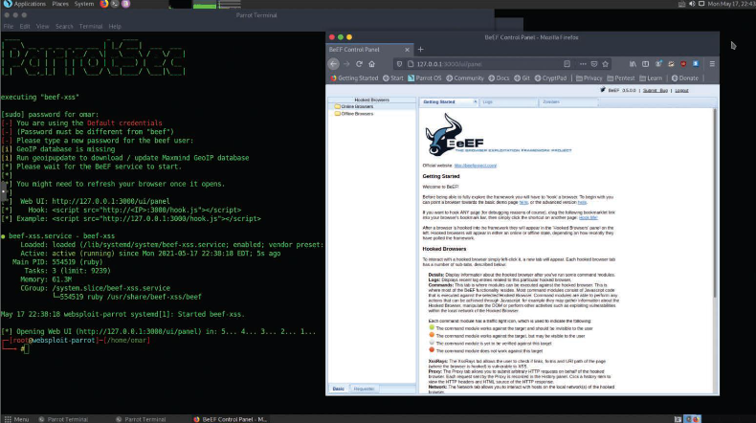
Social Engineering Tools
Browser Exploitation Framework (BeEF) (Cont.)
Launching BeEF
The tool starts a web service on port 3000 by default. From there, the attacker can log in to a web console and manipulate users who are victims of XSS attacks.
Figure 4-12 - Launching BeEF
Notes:
4: Social Engineering Attacks 4.4: Social Engineering Tools
4.4.3: Browser Exploitation Framework (BeEF) (Cont.)

Slide 30
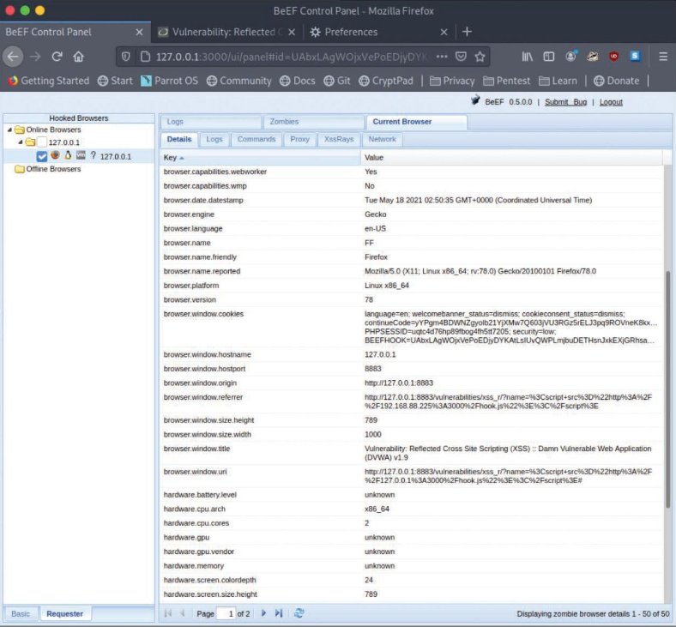
Social Engineering Tools
Browser Exploitation Framework (BeEF) (Cont.)
Figure 4-13 - Stealing a Browser Cookie Using XSS and BeEF
Stealing a Browser Cookie
This is a successful compromise in which the attacker has stolen the user’s session token (browser cookie):
Notes:
4: Social Engineering Attacks 4.4: Social Engineering Tools
4.4.3: Browser Exploitation Framework (BeEF) (Cont.)

Slide 31
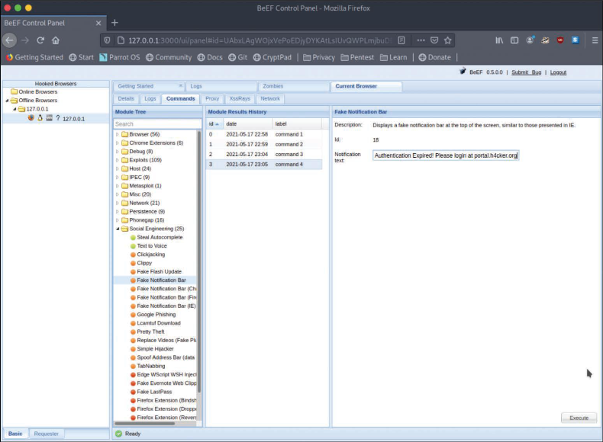
Social Engineering Tools
Browser Exploitation Framework (BeEF) (Cont.)
Figure 4-14 - Sending a Fake Notification to the Victim’s Browser Using BeEF
Once the system is compromised, the attacker can use BeEF to perform numerous attacks (including social engineering attacks). For example, the attacker can send fake notifications to the victim’s browser.
Notes:
4: Social Engineering Attacks 4.4: Social Engineering Tools
4.4.3: Browser Exploitation Framework (BeEF) (Cont.)

Slide 32
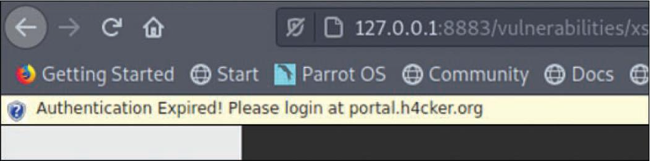
Social Engineering Tools
Browser Exploitation Framework (BeEF) (Cont.)
Figure 4-15 - The Fake BeEF Notification in the Victim’s Browser
This is the fake notification displayed in the victim’s browser:
Notes:
4: Social Engineering Attacks 4.4: Social Engineering Tools
4.4.3: Browser Exploitation Framework (BeEF) (Cont.)
4.4.4: Practice - Browser Exploitation Framework

Slide 33
Social Engineering Tools
Call Spoofing Tools
You can very easily change the caller ID information that is displayed on a phone.
The following are a few examples of call spoofing tools:
SpoofApp: This is an Apple iOS and Android app that can be used to easily spoof a phone number.
SpoofCard: This is an Apple iOS and Android app that can spoof a number and change your voice, record calls, generate different background noises, and send calls straight to voicemail.
Asterisk: Asterisk is a legitimate voice over IP (VoIP) management tool that can also be used to impersonate caller ID.
Notes:
4: Social Engineering Attacks 4.4: Social Engineering Tools
4.4.5: Call Spoofing Tools
4.4.6: Practice - Call Spoofing Tools

Slide 34
Social Engineering Tools
Lab - Explore the Social Engineer Toolkit (SET)
In this lab, you will complete the following objectives:
Part 1: Launching SET and exploring the toolkit
Part 2: Cloning a website to obtain user credentials
Part 3: Capturing and viewing user credentials
Notes:
4: Social Engineering Attacks 4.4: Social Engineering Tools
4.4.7: Lab - Explore the Social Engineer Toolkit (SET)

Slide 35
Social Engineering Tools
Lab - Using the Browser Exploitation Framework (BeEF)
In this lab, you will complete the following objectives:
Load the BeEF GUI Environment
Hook the Local Browser to Simulate a Client-Side Attack
Investigate BeEF Exploit Capabilities
Notes:
4: Social Engineering Attacks 4.4: Social Engineering Tools
4.4.8: Lab - Using the Browser Exploitation Framework (BeEF)

Slide 36
4.5 Methods of Influence
Notes:
4: Social Engineering Attacks 4.5: Methods of Influence

Slide 37
Social Engineering Attacks
Overview
These are social engineering motivation techniques/methods of influence:
Authority - A social engineer shows confidence and perhaps authority–whether legal, organizational, or social authority.
Scarcity and Urgency - It is possible to use scarcity to create a feeling of urgency in a decision-making context. Specific language can be used to heighten urgency and manipulate the victim. Salespeople often use scarcity to manipulate clients.
Social Proof - Social proof is a psychological phenomenon in which an individual is not able to determine the appropriate mode of behavior. Social engineers may take advantage of social proof when an individual enters an unfamiliar situation that he or she doesn’t know how to deal with.
Likeness - Individuals can be influenced by things or people they like. Social engineers strive for others to like the way they behave, look, and talk. Social engineers take advantage of human vulnerabilities to manipulate their victims.
Fear - It is possible to manipulate a person with fear to prompt him or her to act promptly. Fear is an unpleasant emotion based on the belief that something bad or dangerous may take place.
Notes:
4: Social Engineering Attacks 4.5: Methods of Influence
4.5.1: Overview 4.5.2: Practice - Methods of Influence

Slide 38
4.6 Summary
Notes:
4: Social Engineering Attacks 4.6: Summary

Slide 39
Social Engineering Attacks
Summary
This module explained the concepts of pretexting for an approach and impersonation, social engineering attacks, physical attacks, social engineering tools, and methods of influence.
Why do attackers perform social engineering attacks?
What do attackers gain from the victims of social engineering attacks?
What are examples of social engineering tools?
What are methods of influence and how are they used?
Notes:
4: Social Engineering Attacks 4.6: Summary
4.6.1: What Did I Learn in this Module?
4.6.2: Reflection Questions
4.6.3: Quiz - Social Engineering Attacks

Slide 40
Module 4
Terms and Commands
Exploits Social engineering Phishing Vishing Pharming Spear phishing Whaling Elicitation Interrogation Impersonation Motivation techniques USB key drop Malware Pretexting DNS poisoning Reconnaissance SMS phishing | Watering hole attack Pivot attack Tailgating Piggybacking Access control vestibule Multifactor authentication Dumpster diving Shoulder surfing Badge cloning Social-Engineer Toolkit (SET) Browser Exploitation Framework (BeEF) Cross-site scripting (XSS) Cross-site request forgery (CSRF) Cookies SpoofApp SpoofCard Asterik
Notes:
4: Social Engineering Attacks Terms and Commands

